Slide 1
Specificity of machine learning methods in time series analysis
Methods for searching for anomalies in time series;
Specificity of the problems of classification of time series and methods for their solution;
Specificity of regression problems for time series and methods for solving them using machine learning.

Slide 2
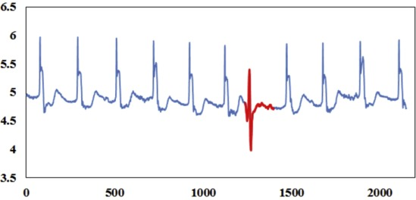
Anomaly detection
Task of Anomaly detection
The outlier or anomaly detection problem for time series is usually formulated as finding sharp and short-time changing of data values relative to some standard or usual series values.
Thus anomaly series parts (or segments) must be significantly distinct from rest of the data in statistical meaning.
Form the definition an anomaly (or outlier) is an observation with at least one variable having an unusual value.
A univariate outlier is an observation with a variable that has an unusual value.
A multivariate outlier is an observation with at least two variables having unusual values.

Slide 3
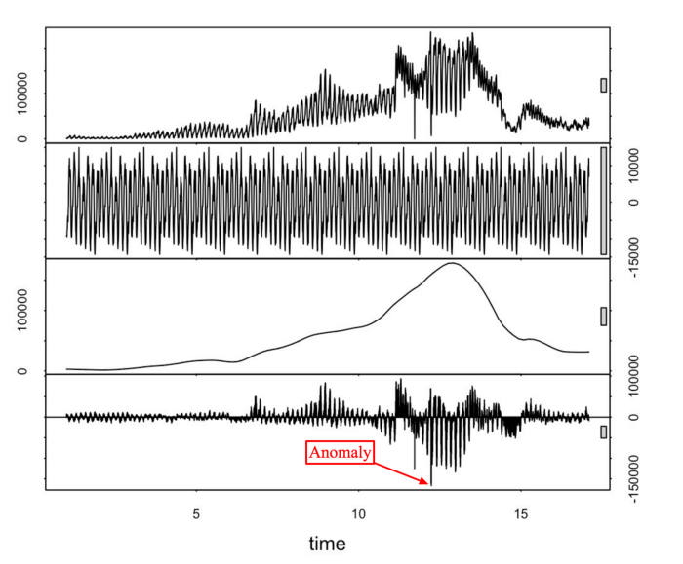
Anomaly detection
In literature, different terms are used that have the same or similar meaning to Anomaly Detection. Types of Anomalies in Time Series Data
Irregular event detection;
Novelty detection;
Deviations discovery;
Outliers detection (unexplainable, inferences, noise);
Change Point Detection;
Fault detection (fault diagnostic);
Fraud detection;
Cyber attack detection;
Misuse detection.

Slide 4
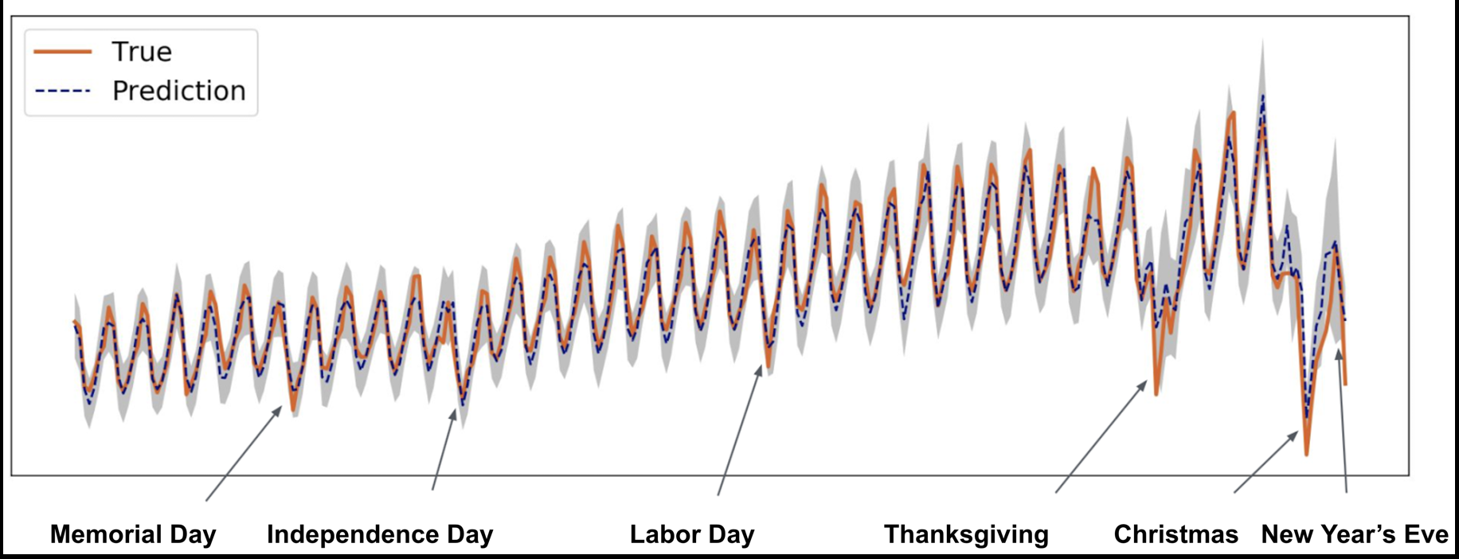
Anomaly detection
Example of the anomaly interpretation in sales prediction.

Slide 5
Anomaly detection. Methods
Methods of Anomaly Detection
The Anomaly detection can be carry out using:
supervised Anomaly detection methods - the series with two classes, labeled as normal and anomaly,
semi-supervised Anomaly detection methods - the series has one class, labeled as normal and many unlabeled data,
unsupervised Anomaly detection methods - the unlabeled series, but you have the rule for choose which normal data must satisfy.

Slide 6
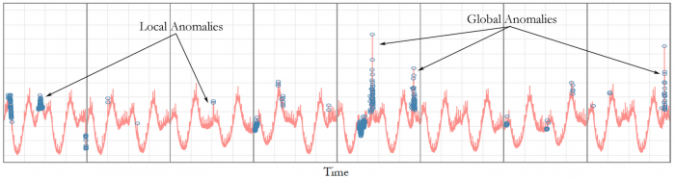
Anomaly detection
There can be distinguished the local and global anomalies.
The local anomaly assume that its value does not overcome general values range.
The global anomaly assume that its value significantly overcome general values range.
Example of local and global point-like anomalies.
Local anomaly mean that its value does not exceeds average envelope value.

Slide 7
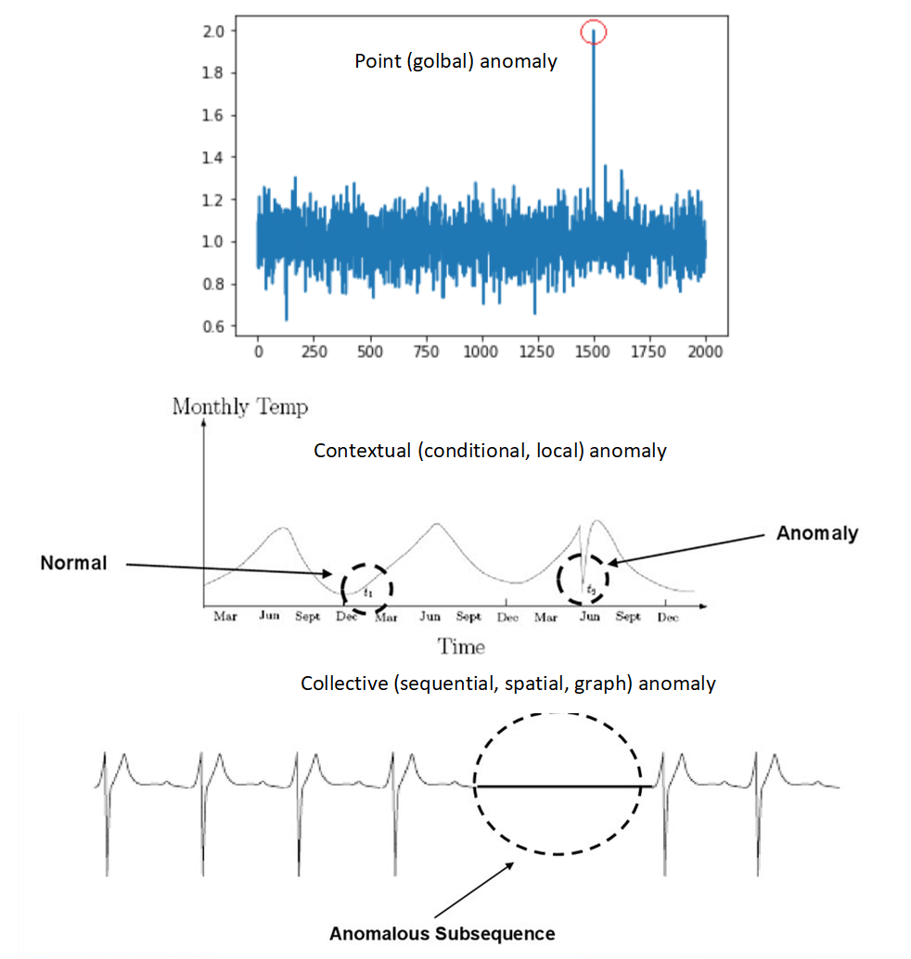
Anomaly detection
The following types of anomalies (by its behavior) can be distinguished.
Sudden point-like metric (or sample) value spike, absence or collapse.
Sudden and short-time change in variance.
Sudden and short-time level shift.
Sudden and short-time envelope change.
Sudden and short-time lack of pattern (like seasonality or changing) or short-time change in pattern behavior.
Combination of the previous cases.
Note
The relative long anomaly behavior are some times named contextual anomaly or collective anomaly.
Contextual anomalies are data instances that are, in human terms, “not being themselves”.

Slide 8
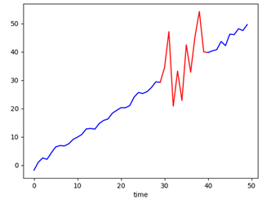
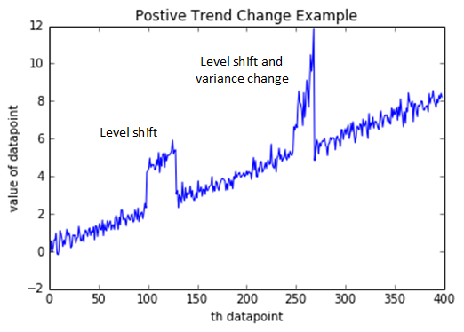
Anomaly detection. Example
Example of variance change anomaly.
Example of level shift anomaly.

Slide 9
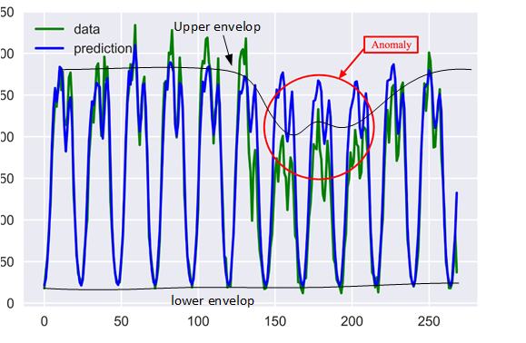
Anomaly detection. Example
Example of envelope change anomaly.

Slide 10
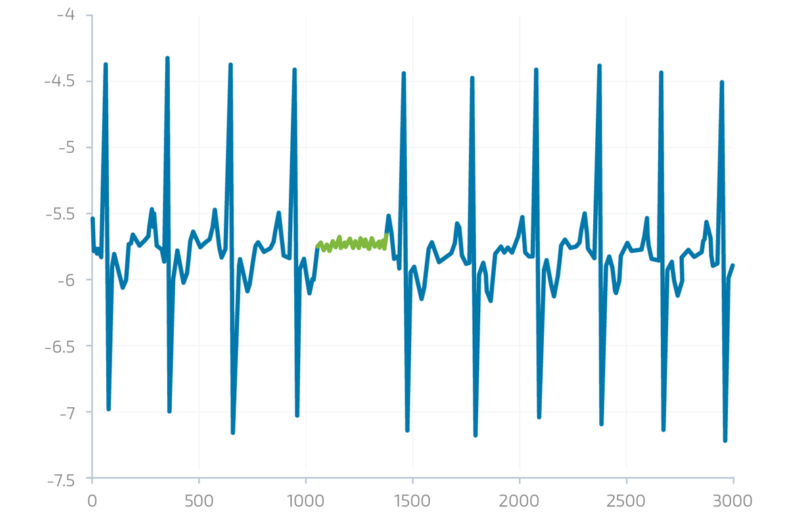
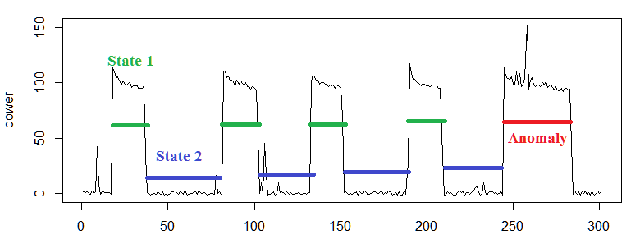
Anomaly detection. Example
Example of sudden lack of seasonality (lack of pattern) and level shift anomaly.
Example of seasonality behavior anomaly (change in pattern).

Slide 11
Anomaly detection approaches
It could be distinguish a several approaches for anomaly detection:
Anomaly detection based on error of the prediction of the time series (and deviation of it).
Anomaly detection based on unusual shapes (patterns, behavior) of the time series.
In each approach we have to introduce some metric for anomalies detection (in classic statistic terms deviation) . Such metric can be, for instance:
Euclidean distance,
MAPE (Mean Absolute Percentage Error),
Some statistic information metric like an entropy or KL divergence.
In All cases the estimated deviation - i.e. error value is proportional to the anomaly score.
If the anomaly score is above a some set threshold, it is marked as an anomaly.
Note the anomaly search can be carried out as for full time series as for results of it decomposition.
Example of anomaly search in the residuals of decomposition.

Slide 12
Anomaly detection. Box Plot
In many cases as base-line for anomaly detection methods comparison the Interquartile Range (IQR) can be applied.
The method is representation of data distribution as 4-quantiles.
The outliers can be considered as all values above 75% or below 25% quantiles.
As a rule IQR are graphically represented as the Box Plot.
If you arrange data from small to large, the mid-point is called the median. The median splits data into two halves. The mid-points of each of these halves is called a quartile.
In other words, you can split data into 3 quartiles — 1st, 2nd and 3rd (the 2nd quartile has a name for it— the median). So the Interquartile Range is the distance between 1st and 3rd quartiles. The theory behind anomaly detection using IQR is that, if a data point is too far from the 1st and 3rd quartile, it probably is an outlier.
IQR can be used standalone for outlier detection, but boxplots below use the same algorithmic theory and are probably more intuitive than IQR.
In the boxplot below, the length of the box is IQR, and the minimum and maximum values are represented by the whiskers.
The whiskers are generally extended into 1.5*IQR distance on either side of the box. Therefore, all data points outside these 1.5*IQR values are flagged as outliers.

Slide 13
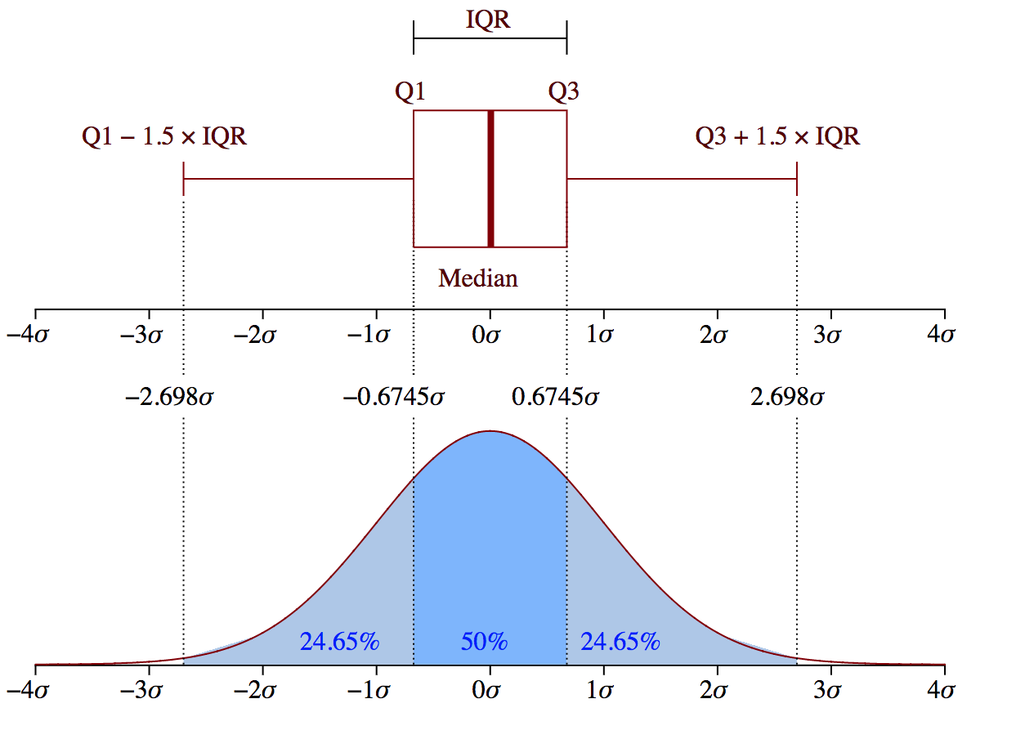
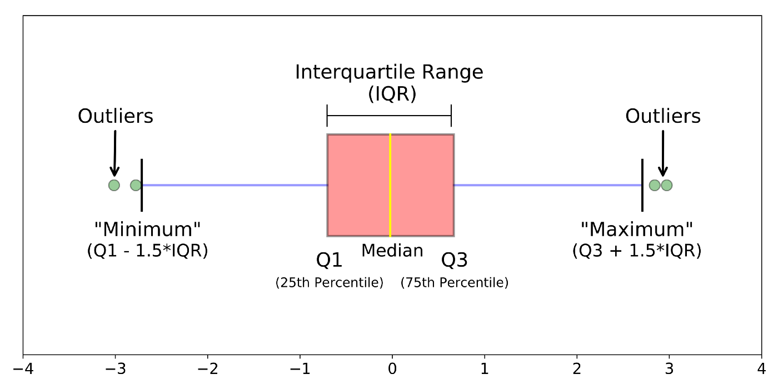
Anomaly detection. Box Plot
Comparison between Box Plot and Normal distribution

Slide 14
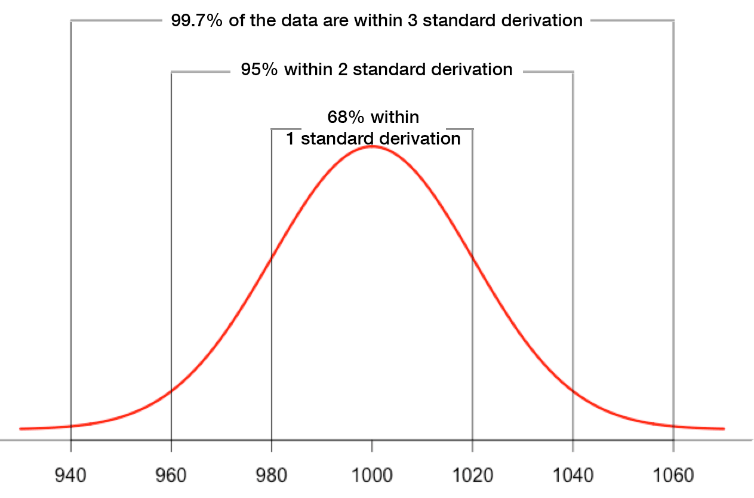
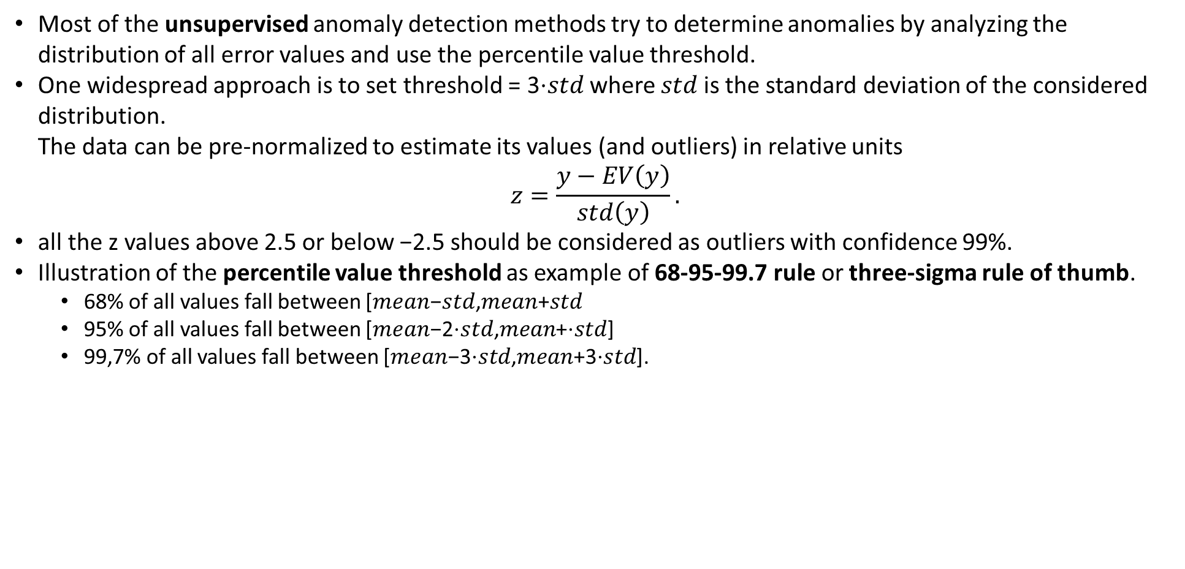
Anomaly detection. Unsupervised methods
Most of the unsupervised anomaly detection methods try to determine anomalies by analyzing the distribution of all error values and use the percentile value threshold.
One widespread approach is to set threshold = 3⋅𝑠𝑡𝑑 where 𝑠𝑡𝑑 is the standard deviation of the considered distribution. The data can be pre-normalized to estimate its values (and outliers) in relative units
$$z=\frac{y−EV\left(y\right)}{std\left(y\right)}.$$
all the z values above 2.5 or below −2.5 should be considered as outliers with confidence 99%.
Illustration of the percentile value threshold as example of 68-95-99.7 rule or three-sigma rule of thumb.
68% of all values fall between [𝑚𝑒𝑎𝑛−𝑠𝑡𝑑,𝑚𝑒𝑎𝑛+𝑠𝑡𝑑
95% of all values fall between [𝑚𝑒𝑎𝑛−2⋅𝑠𝑡𝑑,𝑚𝑒𝑎𝑛+⋅𝑠𝑡𝑑]
99,7% of all values fall between [𝑚𝑒𝑎𝑛−3⋅𝑠𝑡𝑑,𝑚𝑒𝑎𝑛+3⋅𝑠𝑡𝑑].

Slide 15
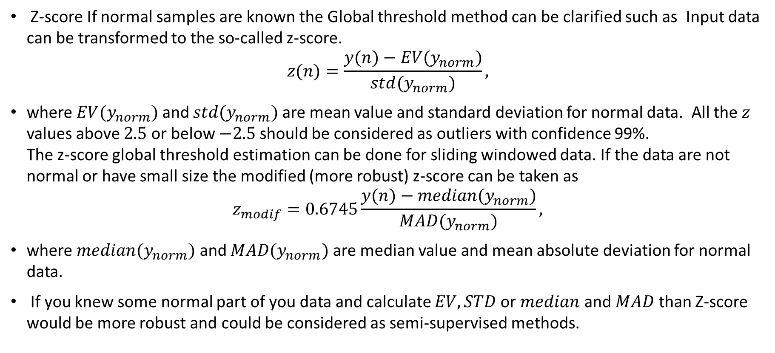
Anomaly detection. Z-score
Z-score If normal samples are known the Global threshold method can be clarified such as Input data can be transformed to the so-called z-score.
$$z(n)=\frac{y(n)−EV(y_{norm})}{std(y_{norm})},$$
where $EV(y_{norm})$ and $std(y_{norm})$ are mean value and standard deviation for normal data. All the $z$ values above $2.5$ or below $−2.5$ should be considered as outliers with confidence 99%. The z-score global threshold estimation can be done for sliding windowed data. If the data are not normal or have small size the modified (more robust) z-score can be taken as
$$z_{modif}=0.6745\frac{y(n)−median(y_{norm})}{MAD(y_{norm})},$$
where $median(y_{norm})$ and $MAD(y_{norm})$ are median value and mean absolute deviation for normal data.
If you knew some normal part of you data and calculate $EV, STD$or $median$ and $MAD$ than Z-score would be more robust and could be considered as semi-supervised methods.

Slide 16
Anomaly detection. Semi-Supervised methods. Eliptic-based method
Gaussian Distribution (Eliptic-based method)
The method is based on the assumption that data are normally distributed.
Thus outliers are lay on the tails of the probability distribution.
The tail part can be set by choose quantiles.
In the case of supervised learning distribution can be calculated by distances between point.
As a rule Mahalanobis distance is using.
Gaussian Distribution method can be considered as unsupervised method - same as the Global threshold method.
Elliptic Envelope is intuitively built on the premise that data comes from a known distribution. If we draw an ellipse around the gaussian distribution of data, anything that lies outside the ellipse will be considered an outlier.
Analogue of Knn with Mahalanobis distance

Slide 17
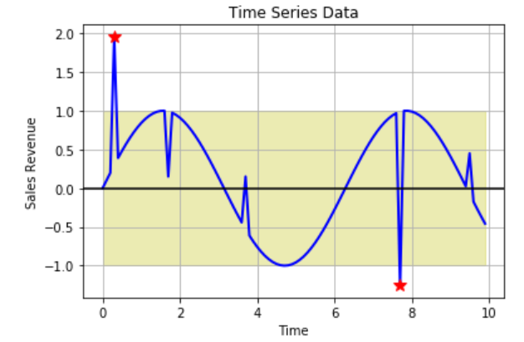
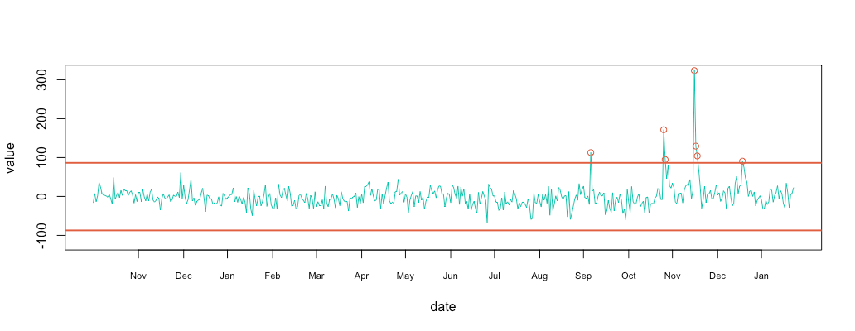
Anomaly detection. Unsupervised methods
Global threshold method - the most simple technique wich suit for global outlier thresholds is the.
The searching can be done by calculating statistical values like mean or median moving average of the data and using a standard deviation to come up with a band of statistical values wich can define the uppermost bound and the lower most bound and anything falling beyond these ranges can be an anomaly.

Slide 18
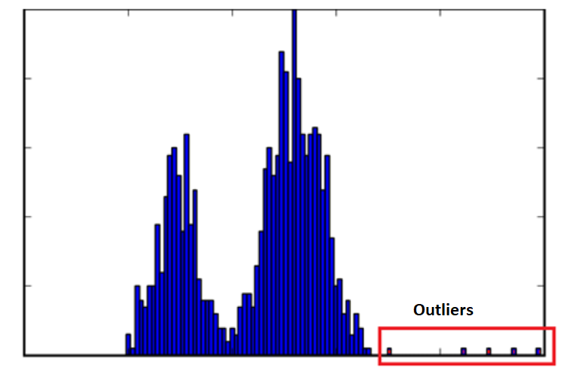
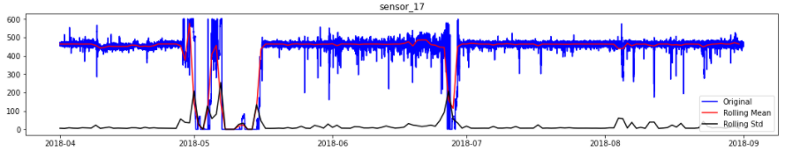
Anomaly detection. Unsupervised methods
Example of threshold selection based on the distribution estimation.
STD Threshold

Slide 19
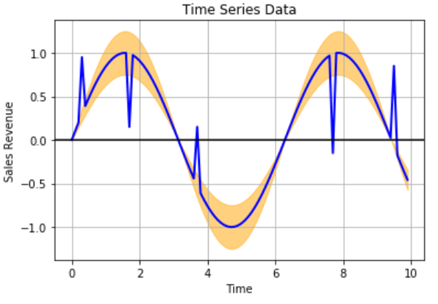
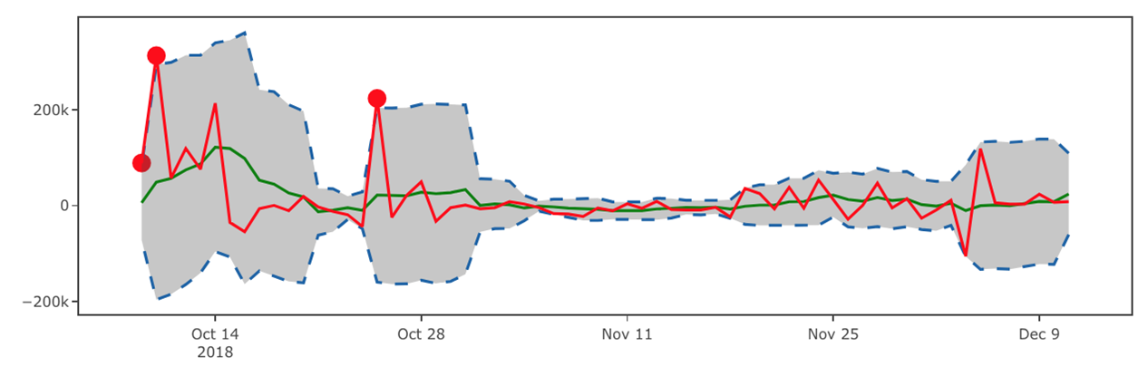
Anomaly detection. Unsupervised methods
Local threshold method for anomalies searching. Analyze anomalies by relative threshold in some moving window. For instance, relative to the average std or mean.

Slide 20
Anomaly detection. Model based
Model based semi-supervised search
The method is based on the creation of the predictive model and set threshold of the prediction error (for instance MAPE for local anomalies).
The error threshold here can be interpreted as confident level for approve hypothesis of outliers.
This approach is suit for both local and global anomalies.
For building the predictive model, popular time series modeling algorithms like moving average, SARIMA, or any Regression or Machine Learning and Deep Learning based algorithm like LSTM can also be used effectively. Note
If model parameters estimation carried out only for "normal" data (with out anomalies) than the task can be considered as semi-supervised.

Slide 21
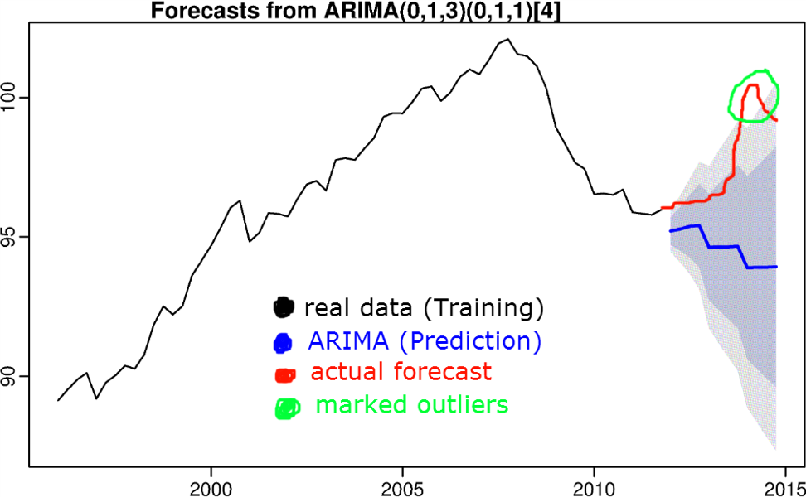
Anomaly detection. Semi-supervised search
Model based example of outlier search by prediction.

Slide 22
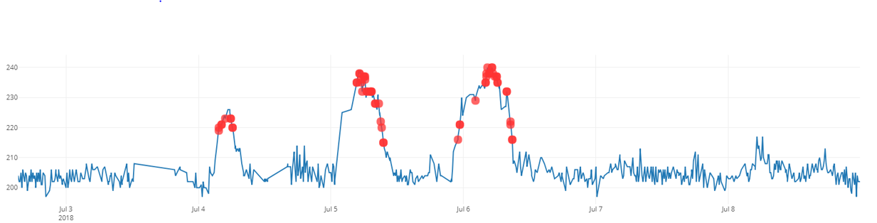
Anomaly detection. Clustering based methods
Clustering based anomaly search
The method is based on the assumption that anomalies will be partied into separate clusters with relatively low amount of elements.
One common pitfall or bottleneck for clustering algorithms for anomaly detection is defining the number of clusters, wich is required by most clustering algorithm as an input.
The Density Based clustering methods like DBSCAN becomes the natural choice due to the lack of number of clusters requirement.
The main draw back of such clustering if anomaly data points repeats many times in a sparse interval, these might not be mapped as an anomaly. So, in such a case, going with a rolling window based clustering.

Slide 23
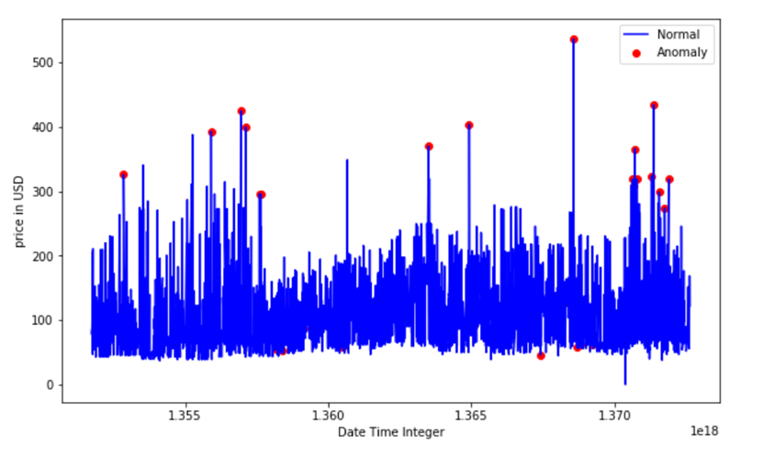
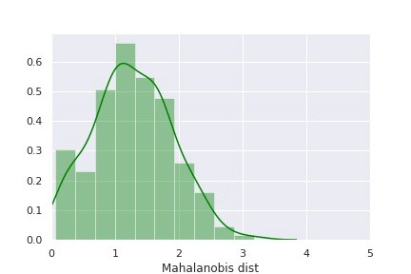
Anomaly detection. Supervised methods. Eliptic-based method
Example of Eliptic-based method work for Time series.
Example of Mlahanobious distance distribution for data

Slide 24
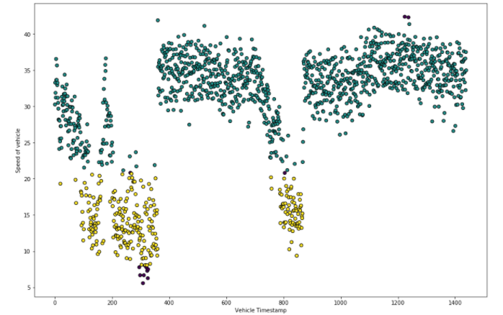
Anomaly detection. Clustering based methods
Specificity of DBSCAN in Anomaly detection:
Any point that has at least minimum samples points within set distance of it will form a cluster.
Any point within maximum cluster distance of a central point, but does not have minimum samples points within distance of itself is called a borderline point and does not form its own cluster.
Any point that is not found to be a central point or a borderline point is called a noise point or outlier and is not assigned to any cluster.
Thus, such points does not contain at least minimum samples points within maximum distance from it or is not within set distance of any determined central point.

Slide 25
Anomaly detection. Clustering based methods
Local Outlier Factor
The density based k-means-like method for unsupervised anomaly detection.
The method is based on the calculation of the inverse of the average distance between each point and its 𝑘 neighbors.
The average of normalized density if local outlier factor.
High LOF value for any point indicate a greater anomaly level. The LOF method is for searching points that are outliers with respect to their local neighborhood (not global). The LOF is equal to the idea that A point is labeled as an outlier if the density around that point is significantly different from the density around its neighbors.
LOF is a metric that reflects the degree of abnormality of the observations and is used to define proximity-based models.
It measures the local density deviation of a given data point with respect to its neighbours.
The idea is to detect the samples that have a substantially lower density than their neighbours.
This density is calculated by ratio involving the k-nearest neighbours algorithm.

Slide 26
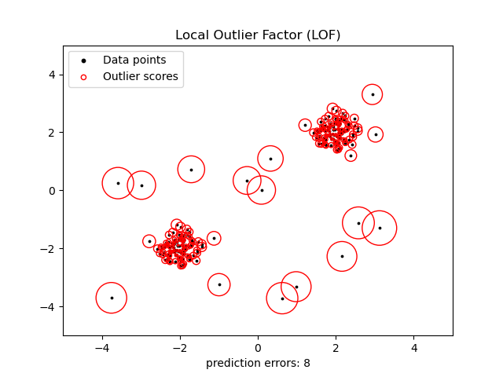
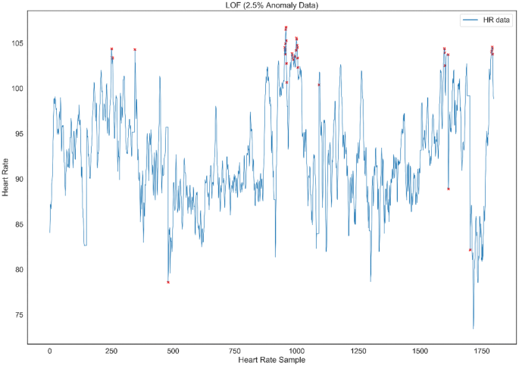
Anomaly detection. LOF method
Illustration of the LOF principle
Example of Local outlier factor
z

Slide 27
Anomaly detection. Isolation forest
Isolation forest
Isolation Forest is a tree ensemble unsupervised method.
In difference with supervised decision tree-based methods here each partition perform randomly.
In Each tree for randomly selected segment or features the partition is carried out also randomly in the range between minimum and maximum values of selected feature or segment.
The anomaly selection is based on the assumption that a normal point requires more partitions to be identified in average (by all trees) than an abnormal point.
As with other outlier detection methods, an anomaly score is required for decision making. Isolation Forest, like any tree ensemble method, is built on the basis of decision trees.
In these trees, partitions are created by first randomly selecting a feature and then selecting a random split value between the minimum and maximum value of the selected feature.
Thus outliers are less frequent than regular observations and are different from them in terms of values (they lie further away from the regular observations in the feature space).
That is why by using such random partitioning they should be identified closer to the root of the tree.
Isolation Forest is an unsupervised machine learning algorithm for identifying anomalies within a dataset by isolating anomalies as they are few and different.

Slide 28
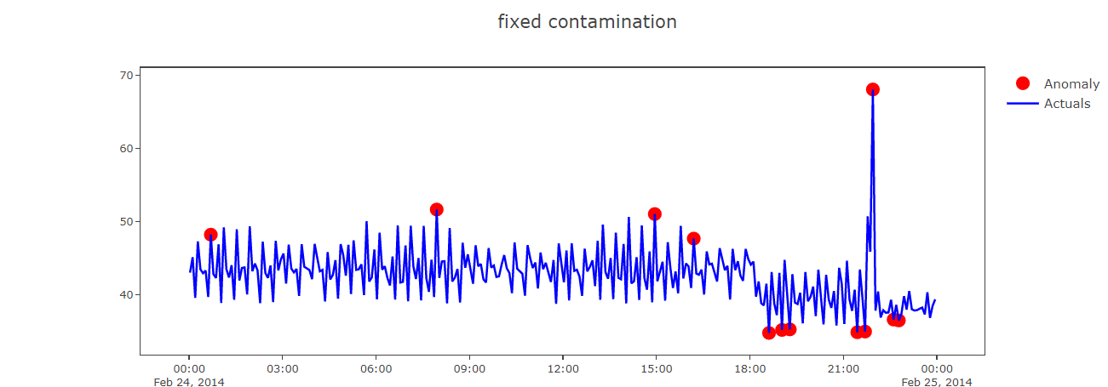
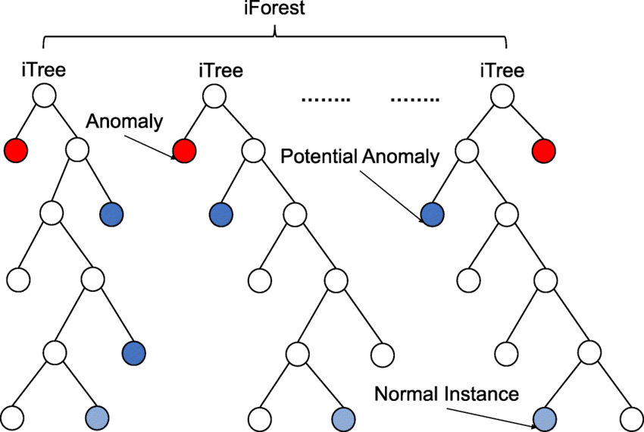
Anomaly detection. Isolation forest
Example of Isolation forest work

Slide 29
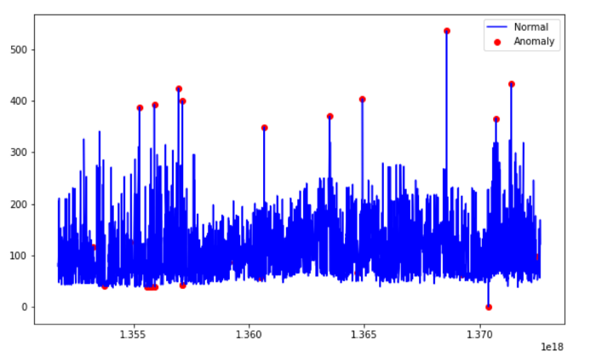
Anomaly detection. Semi-supervised methods. OSVM
One-Class Support Vector Machines, OSVM
The method is based on the idea of build only one support vector (or one non-linear decision boundary) that divide normal data (labeled as normal) from another.
The OSVM require to use kernel-trick, in general with RBF kernel. It is necessary to build a spherical boundary around the labeled data.
The solution of the OSVM problem is the hyperplane (support vector) that maximizes the distance from labeled data to the origin point (zero point). In this case the volume of this hypersphere is minimized, to minimize the effect of incorporating outliers in the solution.
The method is very sensitive for dirty in the labeled data.Actually method can be considered as one class vs rest task.
In OSVM we are implicitly assume that after kernel trick abnormal data will be highly spreaded in the near-zero -point area

Slide 30
Anomaly detection. Semi-supervised methods. Autoencoder
Autoencoder based anomaly detection
The error of the trained autoencoder reconstruction result similar to the Anomaly Score.
The network is training on the data the most of them are assume to be normal.
The method can be considered in the unsupervised and semi-supervised tasks. AE is mainly used for feature extraction and dimension reduction as unsupervised method. But it also good for anomaly detection problems.
Autoencoder consists of encoding and decoding parts.
In encoding part, main features are extracted wich represents the patterns in the data, and then each samples is reconstructed in the decoding part. The reconstruction error will be minumum for normal samples.
On the other hand, the model is not able to reconstruct a sample that behaves abnormal, resulting a high reconstruction error.
So, basically, the higher reconstruction error a sample has, the more likely it is to be an anomaly.

Slide 31
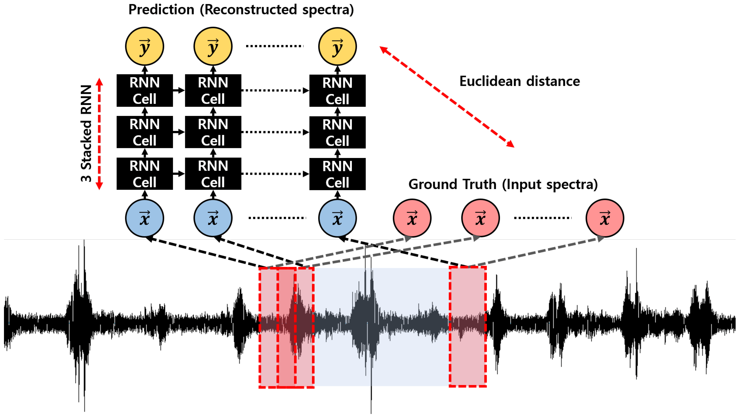
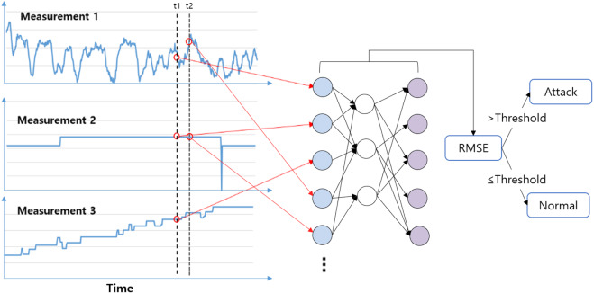
Anomaly detection. Semi-supervised methods. Autoencoder
Example of RNN-based autoencoder based anomaly detection.
Note In the anomaly detection task Autoencoder can be considered as semi-supervised task if training is performing only on normal data.

Slide 32
Anomaly detection. Supervised methods.
Supervised methods
Supervised Neural Network and other machine learning
The supervised task can be solved in two ways
Based on the deviation all data into two classes - normal data and abnormal data.
Based on the regression task - by estimation the error of prediction, using supervised samples.
Note
In the regression-like case the anomaly detection can be also considered as semi-supervised task.
The popular methods of the supervised machine-learning based anomaly detection are:
SVM
Random Forest
k-Nearest Neighborhoods
Neural-Network.

Slide 33
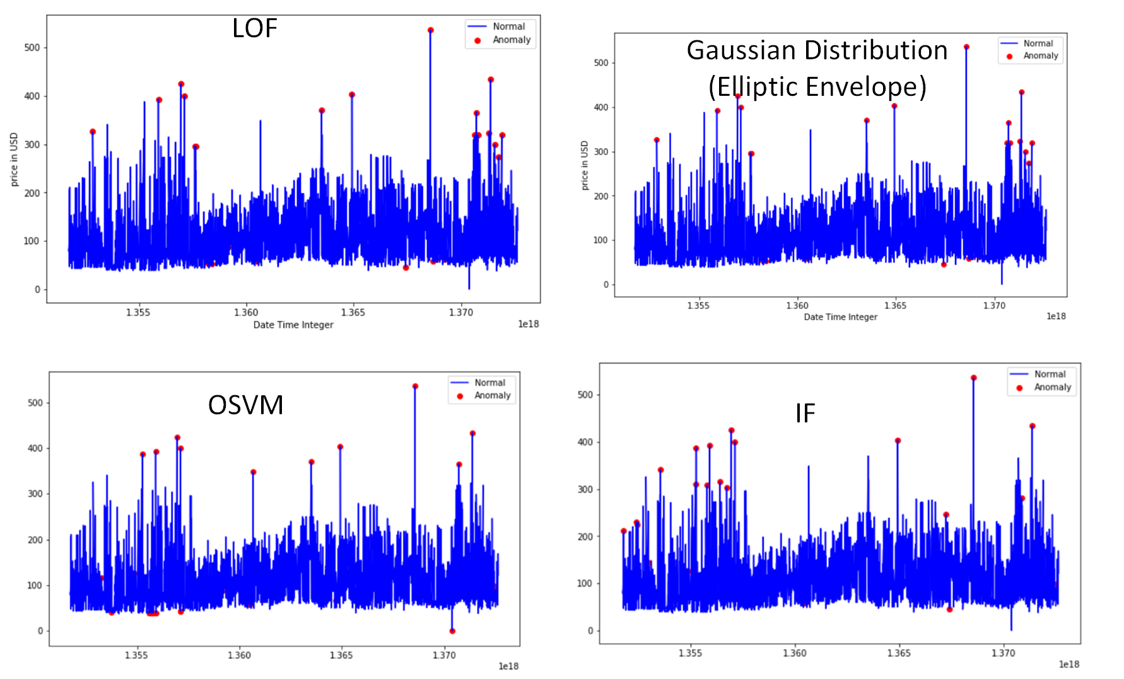
Anomaly detection. Comparison

Slide 34
Supervised Classical ML
Machine-learning methods for TS classification
There are two main tasks of using supervised machine learning for time series analysis.
Regression (prediction, parameter estimation);
Classification.
Common, but problematic solution to time series classification is to treat each time point as a separate feature and directly apply a standard learning algorithm (e.g. scikit-learn classifiers).
In this approach, the algorithm ignores information contained in the time order of the data.

Slide 35
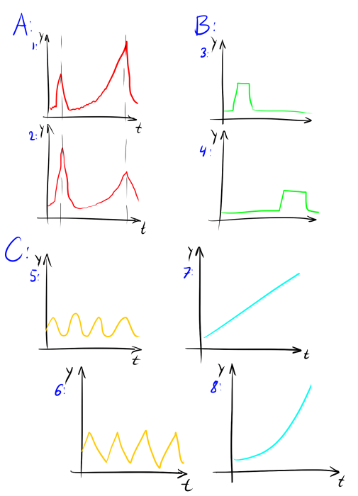
Time Series Segments. Specificity of Segments
Actually there can be several types of Segments analysis for time series.
Similarity in time behavior
like for 1 and 2 on the picture below, case A.
Similarity in shape without time relation
like for 3 and 4 on the picture below, case B.
Similarity in pattern or structure behavior
like for 5 and 6 by seasonality period, case C.
like 7 and 8 by trend (growing trend without), case D.
Choose of the clustering type depends on the choose of the data representation or algorithm of similarity searching.
Based in the task you will need to select the measure.
e.g. in spectrum domain similarity in shape behavior will be represented in amplitude spectrum similarity. The same for 5 and 6 instances.

Slide 36
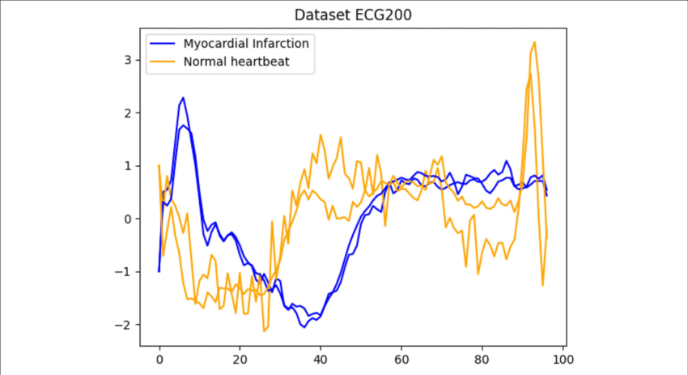
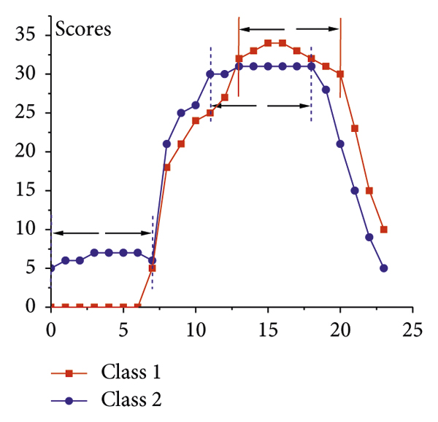
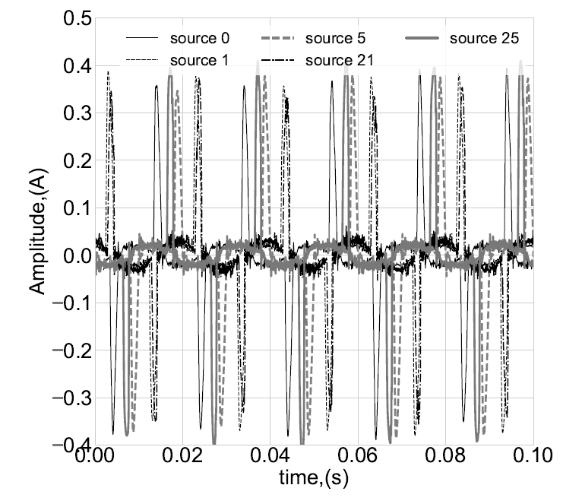
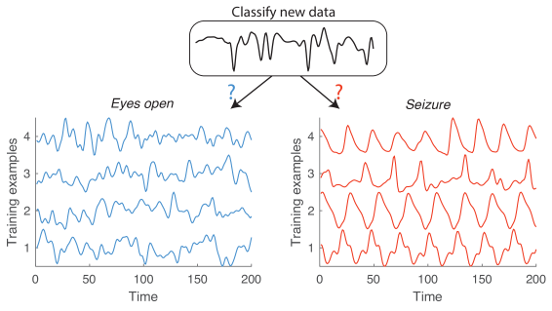

Slide 37
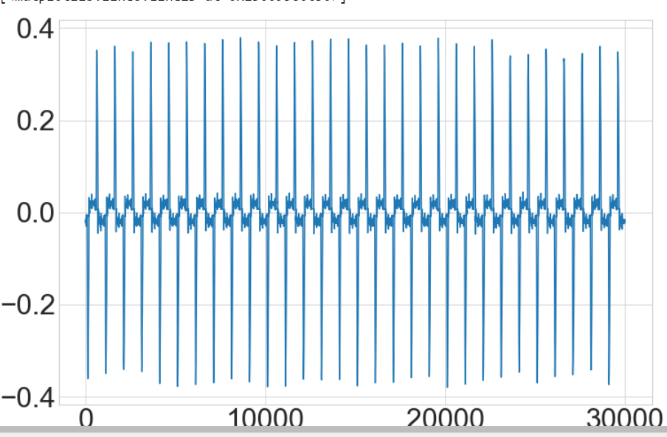
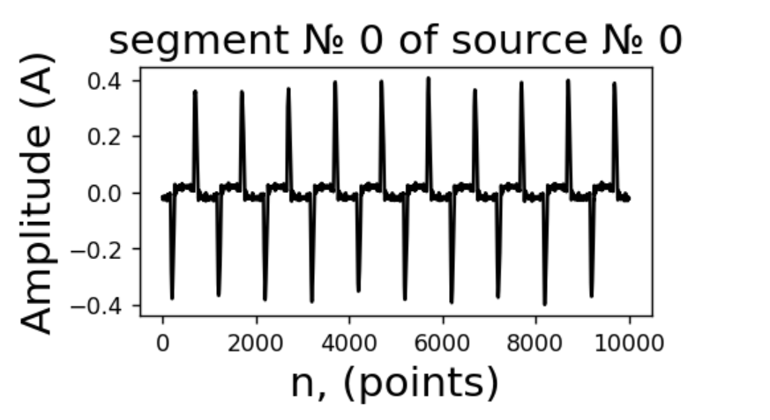
segmets
For classification we need to have some segments

Slide 38
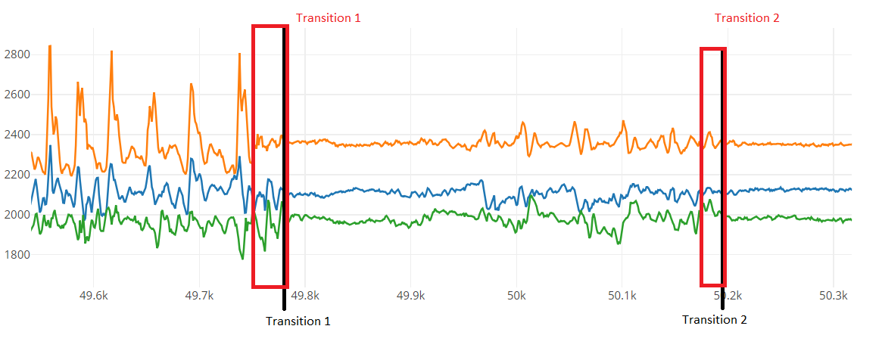
For raw data, some algorithms requires to use whole segment or we can divide intervals
Intervals could be selected:
Manually set
Randomly selected
Selected supervise (by CV)
For each segment you may one or several intervals of different length.

Slide 39
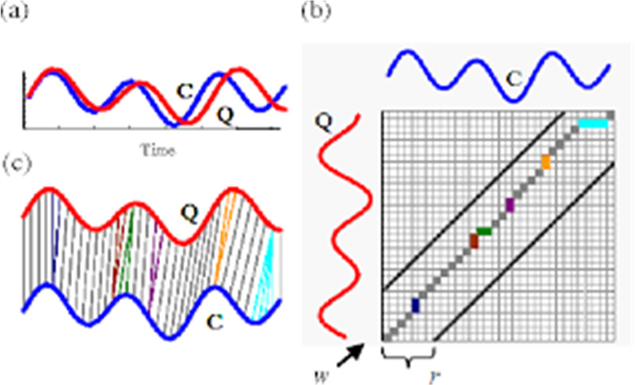
Supervised Classical ML
Most of the time series classifiers are:
Distance-Based Classification (KNN with distance).
Ensemble of decision trees (random forest, Time Series Forest).
Bag of Symbols Dictionary (BOSS).
Shape or its part based classifiers.
Support Vector Machine.
XGBoost.
Example of kNN-DTW Classifier

Slide 40
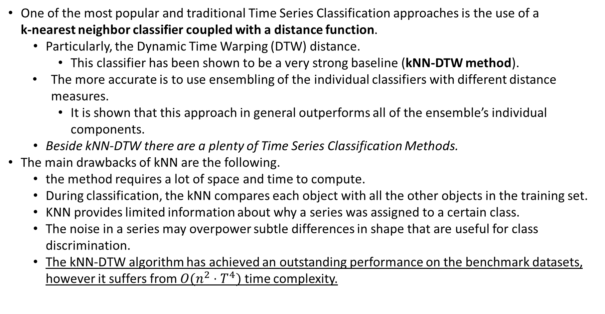
Supervised Classical ML. K-nearest neighbor
One of the most popular and traditional Time Series Classification approaches is the use of a k-nearest neighbor classifier coupled with a distance function.
Particularly, the Dynamic Time Warping (DTW) distance.
This classifier has been shown to be a very strong baseline (kNN-DTW method).
The more accurate is to use ensembling of the individual classifiers with different distance measures.
It is shown that this approach in general outperforms all of the ensemble’s individual components.
Beside kNN-DTW there are a plenty of Time Series Classification Methods.
The main drawbacks of kNN are the following.
the method requires a lot of space and time to compute.
During classification, the kNN compares each object with all the other objects in the training set.
KNN provides limited information about why a series was assigned to a certain class.
The noise in a series may overpower subtle differences in shape that are useful for class discrimination.
The kNN-DTW algorithm has achieved an outstanding performance on the benchmark datasets, however it suffers from $O(n^{2}⋅T^{4})$ time complexity.

Slide 41
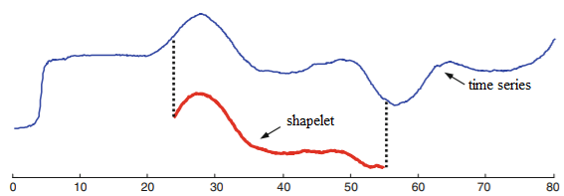
Supervised Classical ML. Shapelet-Based Classifiers
Shapelets are subsequences, or small sub-shapes of time series that are representative of a class.
Shapelet-based classifiers search for shapelets with greatest discriminatory power.
In the training set the presence of certain shapelets make one class more likely than another.
In the training data each shapelet considered is evaluated according to some information gain criteria (e.g. entropy).
The strongest non-overlapping shapelets are retained.
Shapelets can be used to detect "phase-independent localised similarity between series within the same class".
For binary classification, a shapelet is discriminant if it is present in most series of one class and absent from series of the other class.

Slide 42
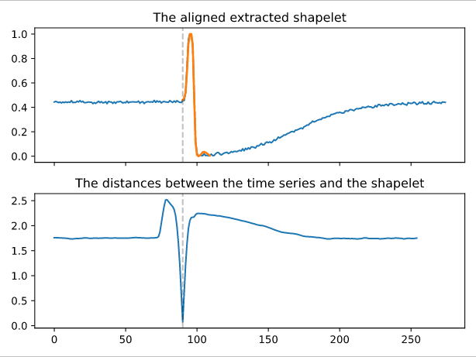
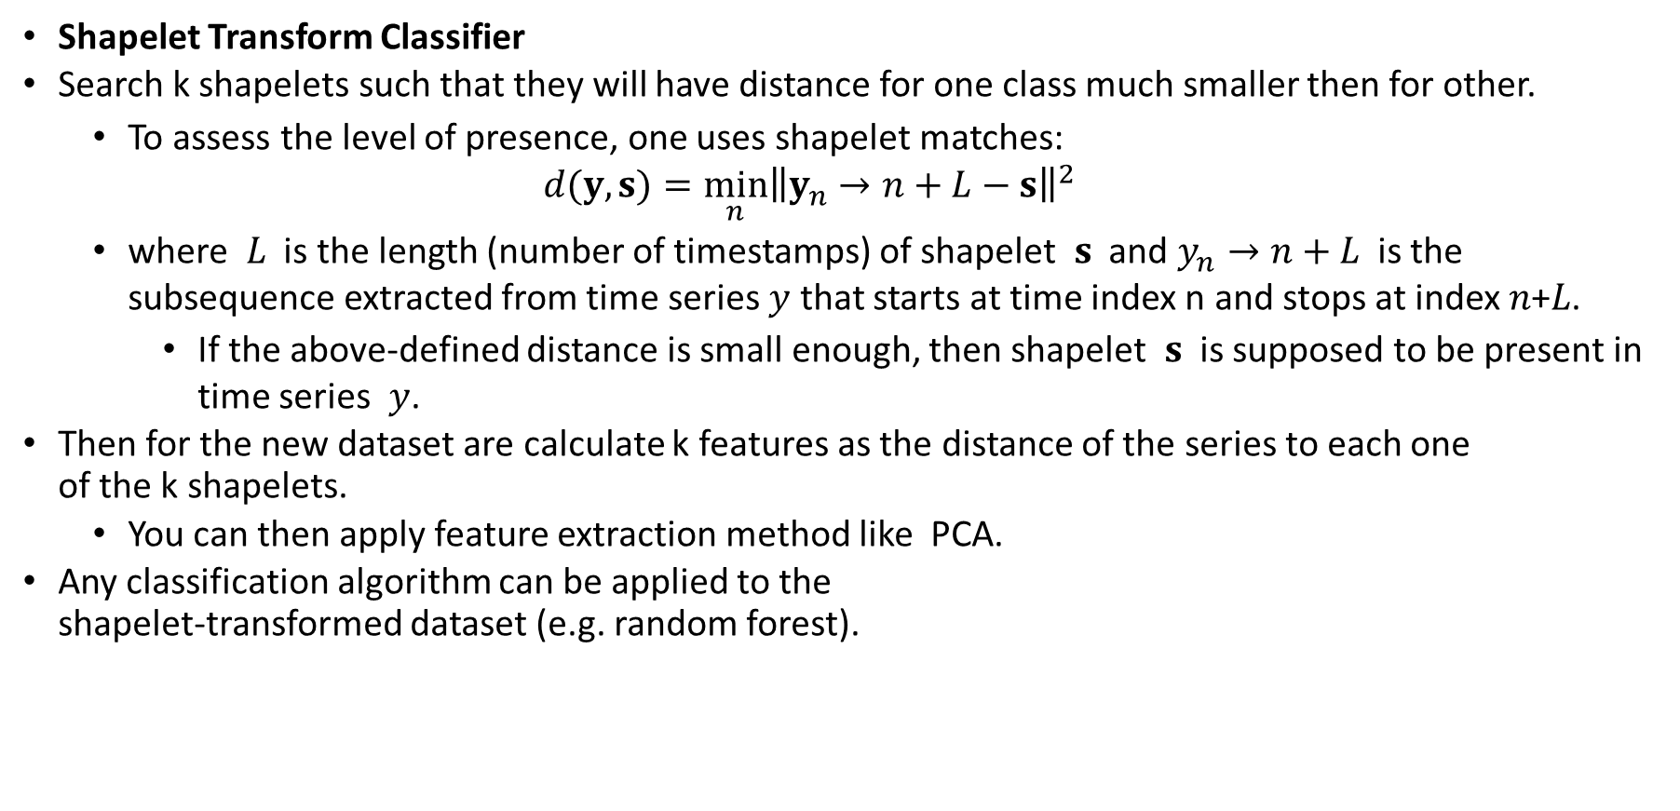
Supervised Classical ML. Shapelet-Based Classifiers
Shapelet Transform Classifier
Search k shapelets such that they will have distance for one class much smaller then for other.
To assess the level of presence, one uses shapelet matches:
$$d(y,s)=\min_{n}{\left\|y_{n}→n+L−s\right\|}^{2}$$
where $L$ is the length (number of timestamps) of shapelet $s$ and $y_{n}→n+L$ is the subsequence extracted from time series $y$ that starts at time index n and stops at index 𝑛+𝐿.
If the above-defined distance is small enough, then shapelet $s$ is supposed to be present in time series $y$.
Then for the new dataset are calculate k features as the distance of the series to each one of the k shapelets.
You can then apply feature extraction method like PCA.
Any classification algorithm can be applied to the shapelet-transformed dataset (e.g. random forest).

Slide 43
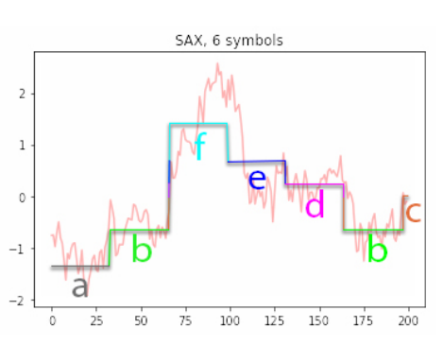
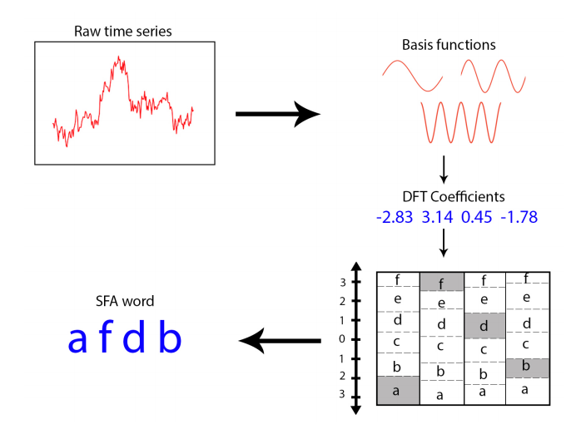
Supervised Classical ML. Dictionary-Based Classification
For obtain dictionary
Transform the series into segments or by sliding window with some step.
For each of segment (or by sliding across segment with window) build a one or bag of words,
for instance by quantization, rounding to integer or using some specific algorithms.
the resulted "turnicated" values can be corresponded to some virtual and finite dictionary of words
each word with equal length (with finite number of possible symbols and its possible combinations - words).
Build a histogram of words meeting amount for each window.
Finally, any classifier can be trained on the word histograms extracted from the series.
SFA

Slide 44
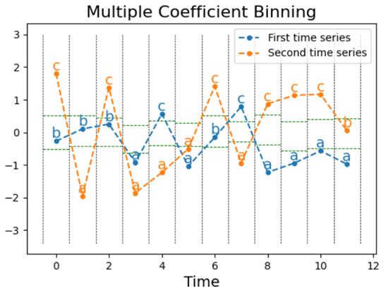
Supervised Classical ML. BOSS - Dictionary-Based Classification
The one of the most popular method for dictionary obtaining is
Bag of SFA Symbols (Bag of Symbolic Fourier Approximation (SAF) Symbols, BOSS)
Word features for BOSS classifiers are extracted from series using the Symbolic Fourier Approximation (SFA) transformation:
Calculate the Fourier transform of the window (the first term is ignored if normalization occurs).
Quantization the first L Fourier terms into symbols to form a "word".
for instance round to the integer part or using Multiple Coefficient Binning (MCB).
MCB is a supervised algorithm that bins continuous time series into a sequence of letters.
A dictionary of words is constructed as the window slides, recording a count of each word frequency.

Slide 45

Supervised Classical ML. BOSS - Dictionary-Based Classification

Slide 46

Supervised Classical ML. ROCKET Classifer
ROCKET (RandOm Convolutional KErnel Transform ) Classifier is type of the Shapelets-based classifiers is based on the so-called ROCKET transforms.
The ROCKET transforms are the time series transforms using random convolutional kernels (random length, weights, bias, dilation, and padding).
ROCKET Classifer computes two features from the resulting feature maps (after transformations):
the max value, and the proportion of positive values to all (ppv).
The transformed features are used to train a linear classifier.

Slide 47
Supervised Classical ML. Time series forest (TSF)
TSF classifier adapts the random forest classifier to series data.
TSF is a Interval-based classifier.
Split the series into random intervals, with random start positions and random lengths.
Extract summary features (mean, standard deviation, slope and e.t.c.) from each interval into a single feature vector.
Train a decision tree on the extracted features.
Repeat steps 1–3 until the required number of trees have been built or time runs out.
New series are classified according to a majority vote of all the trees in the forest.
In a majority vote, the prediction is the class that is predicted by the most trees of the forest.
Advantages of TSF:
Time series forest can outperform baseline competitors, such as kNN-DTW.
Time series forest is also computationally efficient.
Time series forest is an interpretable model.
Time feature importance can be extracted (i.e. estimated) from time series forest.

Slide 48
Supervised Classical ML. Random Interval Spectral Ensemble (RISE)
RISE is a popular variant of time series forest. In difference with TSF RISE:
uses a single time series interval per tree
it is trained using spectral features extracted from the series, instead of summary statistics.
RISE use several series-to-series feature extraction transformers, including:
Fitted auto-regressive coefficients;
Estimated autocorrelation coefficients;
Power spectrum coefficients (the coefficients of the Fourier transform);
The RISE algorithm:
Select random interval of a series (length is a power of 2), For the first tree, use the whole series;
For the same interval on each series, apply the series-to-series feature extraction transformers (autoregressive coefficients, autocorrelation coefficients, and power spectrum coefficients) and form a new training set by concatenating the extracted features.
Train a decision tree classifier and ensemble trees
Class probabilities are calculated as a proportion of base classifier votes.
RISE controls the run time by creating an adaptive model of the time to build a single tree.
This is important for long series (such as audio), where very large intervals can mean very few trees.

Slide 49

Supervised Classical ML. HIVE-COTE
The Hierarchical Vote Collective of Transformation-based Ensembles (HIVE-COTE) is a meta ensemble built on the classifiers discussed previously.
HIVE-COTE predictions are a weighted average of predictions produced by its members:
shapelet transform classifier,
BOSS,
Time Series Forest,
RISE.
Each sub-classifier estimates the probability of each class.
The control unit then combines these probabilities (CAPWE).
The weights are assigned as the relative estimated quality of the classifier found on the training data.

Slide 50
Supervised Classical ML. Time series forecast
There are several types of the time series forecast problem solution
Stochastic models (or model based approach). The methods can be divided on non-parametric and parametric.
non-parametric such as moving average, Holt-Winter, simple regression:
based on the analytical model of the series behavior,
easy to train and retraining,
low probability of overfitting,
provide the best accuracy for comparably simple data (stationary with Gaussian noises or some simple noises, like symmetric-distributed ones).
accuracy highly depends on the amount of data for training.
the performance dramatically decrease if the data behavior are differs from the assumed one (form the assumed statistical hypothesis).
Work well only for univariate case.
Can be easy interpreted.
Can have analytical solution (for linear regression fore instance).
For it work wee need to know distribution type or make strong assumption about it.

Slide 51
Supervised Classical ML. Time series forecast
parametric such as ARIMA, GARCH, Prophet and e.t.c.
based on the analytical-parametric model of the series behavior,
simple for understanding and implementation,
easy to train and retraining,
provide sufficient high accuracy of prediction,
better to work with univariate data,
better with relatively simple non-stationarity data,
accuracy highly depends on the amount of data for training,
accuracy highly depends on the choose of the hyperparameters values (here hyperparameters are analogue of the statistical hypothesis in the non-parametric approach),
cannot handle the complex non-linear relationship among the data,
worth performance for huge multivariate non-stationarity series (especially in the case of non-normalized data with different in behavior and e.t.c).
Work well only for univariate case.
Can be easy interpreted.
More robust to inferences in the case of well selected model (due to super resolution with inferences for small datasets).
low performance on the large datasets with complex relation (missing values, outliers, nonuniform discretization).

Slide 52
Supervised Classical ML. Time series forecast
Data-driven models (or machine learning approach)
The methods can be divided on classical machine learning and deep neural network.
Classical data-driven models (or machine learning approach).
Such methods as Support Vector Regression (SVR), Regression Random forest, XGBoost, and e.t.c.
Allow to work with highly non-linear data.
No need of statistical hypothesis for model.
Good at handling non-stationary relationships among data.
Easy to train.
Accuracy highly depends on the choose of the hyperparameters values.
Implicitly dependence of the chose model and data on the prediction results.
Accuracy highly depends on the similarity between trained data and inference one.
Hard to achieve comparable accuracy with model based approach for relatively simple data.

Slide 53
Supervised Classical ML. Time series forecast
Deep Neural Network.
No need of statistical hypothesis or a specific model form.
Can approximate any function with skipped data, anomalies and other irregular patterns.
Allow to work with huge multivariate data series with complex relation of behavior among data.
Automatically extract and handle complex features and dependency relationships.
Require hard tuning of the hyperparameters.
Frequently the ensemble of the networks need to achieve high accuracy.
Hard to retraining.
Hard to achieve comparable accuracy with model based approach for relatively simple series.
The choose of the specific methods is depends on the task.
For simple and univariate data the model based approach are recommended.
For complex and multivariate data in huge amount the Data-driven models could provide better performance.

